Slide 1
Integrating ACC to BIM

Slide 2
Requirements
Account with Executive Overview access
Using Autodesk Data Connector in Insight module
Data Connector allows project administrators and members with executive overview access to extract data from projects by running or scheduling data extractions
Run Extraction / Schedule – to extract data from project level or account level

Slide 3
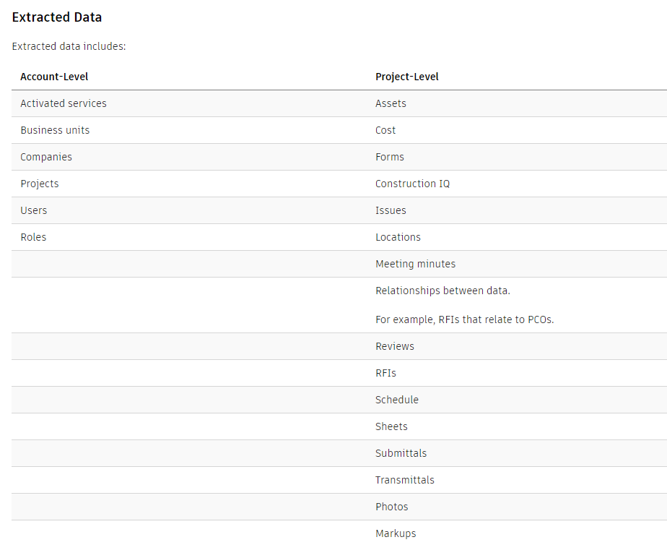

Slide 4
Insight / Data Connector

Slide 5
Reference Links
DOCS Help | Data Connector | Autodesk

